Slide 1
ENDANGERED SPECIES IN CROATIA

Slide 2
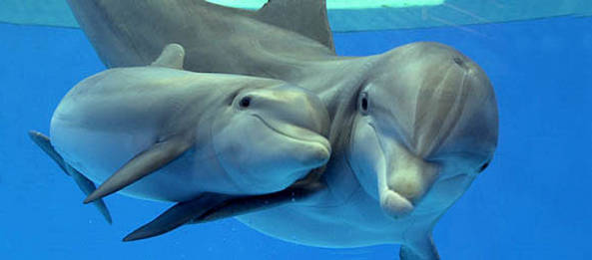
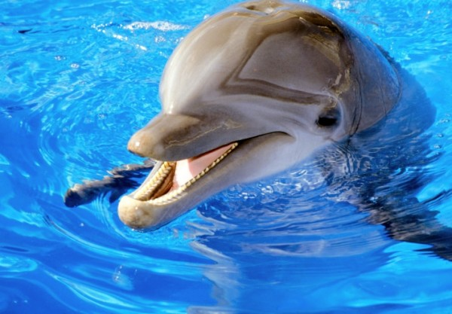
Bottlenose dolphin

Slide 3
Classification
ballen whales
toothed whales

Slide 4
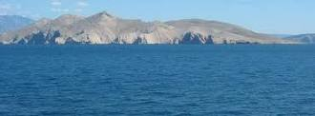
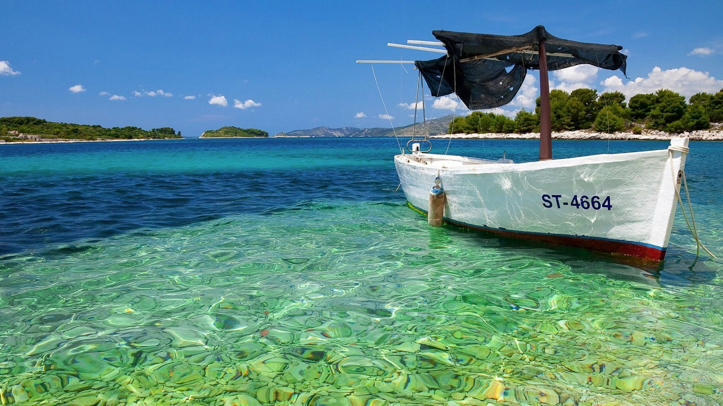
HABITAT
The Adriatic Sea

Slide 5
DESCRIPTION
elongated hydrodynamic body shape
color varies from dark blue to brown-gray on the back, over a light gray on the sides and white on the belly
Length: 2-4 meters
weight may range between 100 and 500 kg

Slide 6
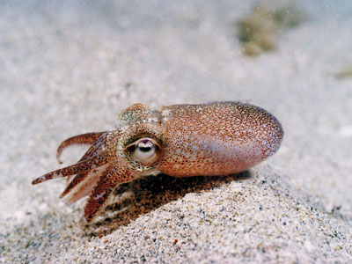
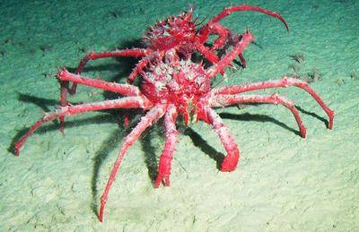
FOOD
cephalopods
crustaceans
molluscs

Slide 7
YOUNG DOLPHINS
cubs
born in summer
mother and cub are in close contact until the calf is not copable of carring for themselves

Slide 8
LENGTH OF LIFE
up to 50 years

Slide 9
WHY THEY ARE ENDENGARED
Illegal hunting (poaching)
Habitat destruction

Slide 10
WHAT IS DONE TO PROTECT THEM
„Adriatic Project”
implements and promotes the study
conservation of cetaceans and other marine organisms and marine environment as a whole

Slide 11
THANK YOU FOR YOUR ATTENTION!
Made by: Magdalena Laić, 8.b

