Slide 1
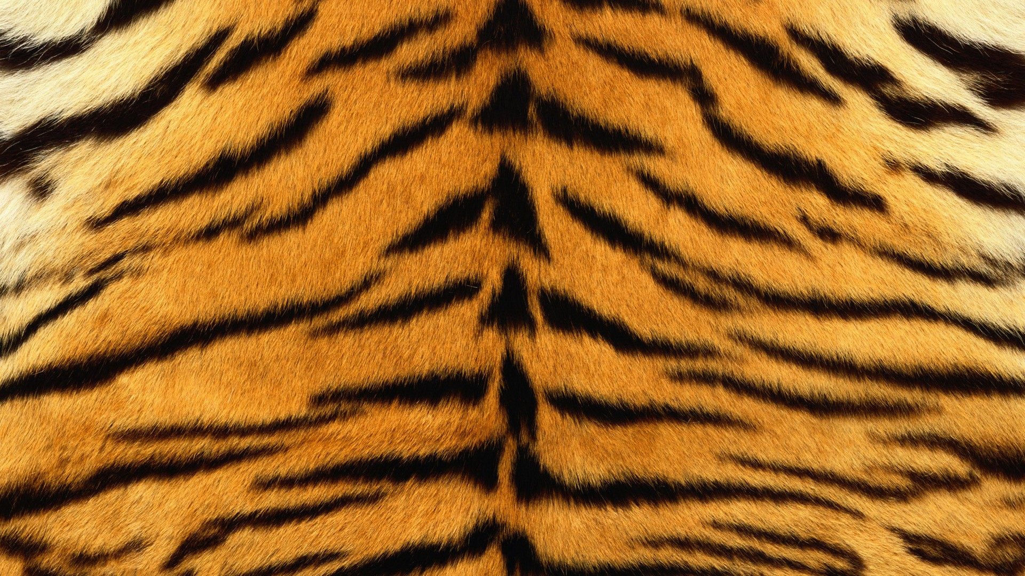
Tiger

Slide 2
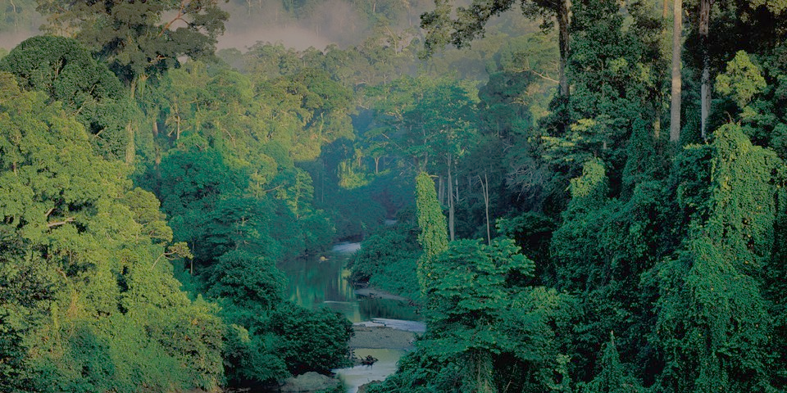
Habitat
Asian jungles
Siberia
Southeast Asia

Slide 3
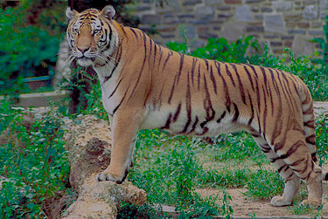
Size
140 cm
The tail is about 60 cm

Slide 4
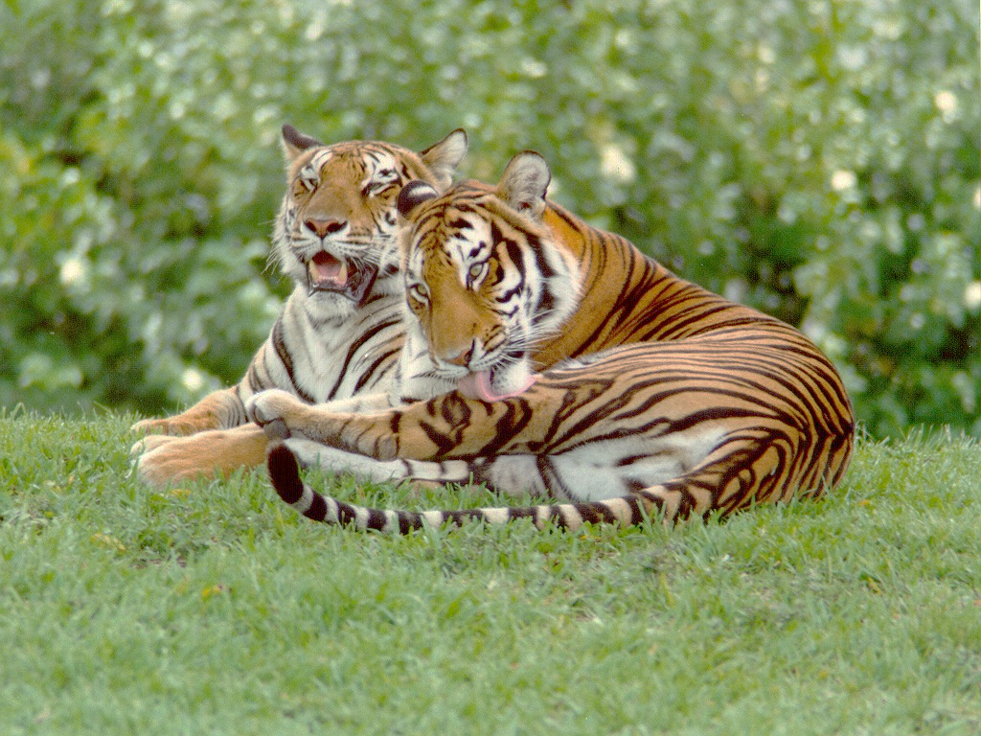
Weight
Males weigh 120 kg
Females weight about 90 kg

Slide 5
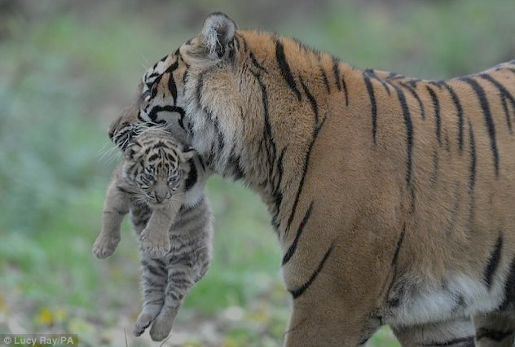
Population
5000-7000
In fact , more tigers are in zoos
than in the wild
Female in one litter gives 2 to 4
cubs , also is not strange to be
up to six newborns

Slide 6
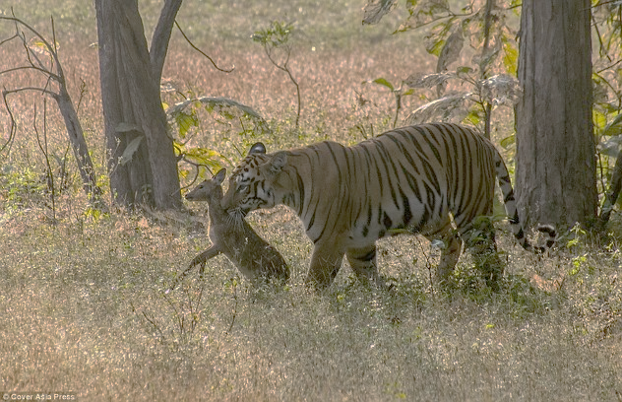
Diet
It takes approximately 9 kg of meat
a day
They are carnivores

Slide 7
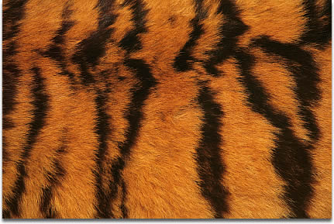
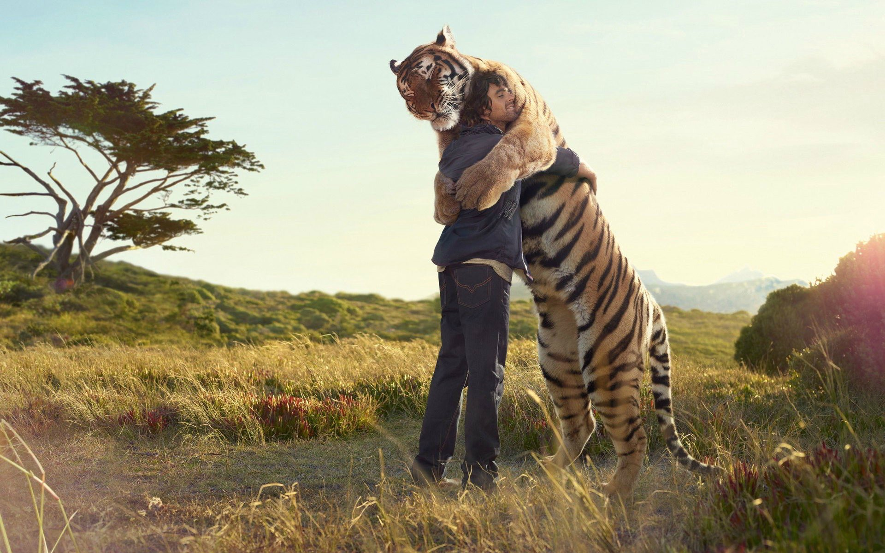
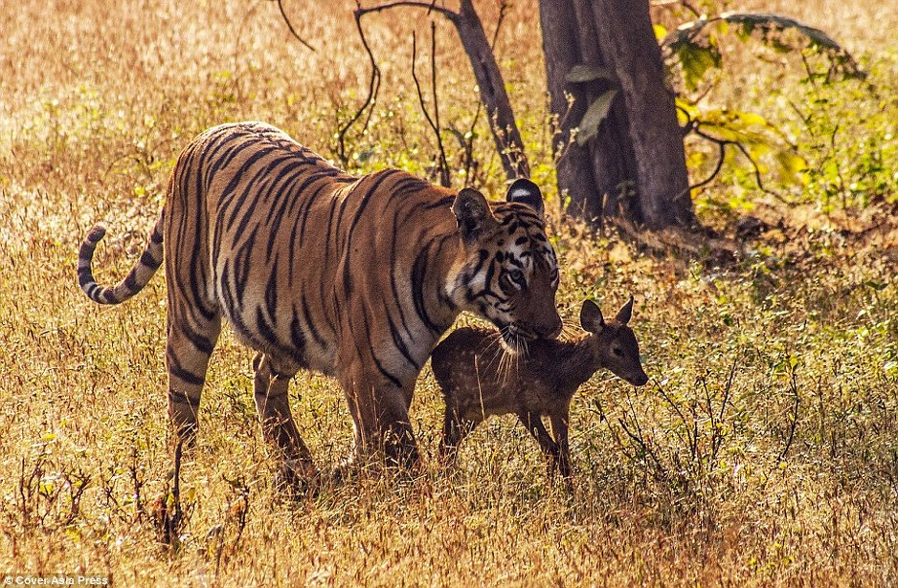
Behaviour
Tigers are :
timid
secretive
essentially solitary
If they trained, they are
kindly to people and animals

Slide 8
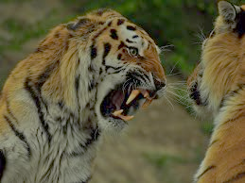
Enemies
Mostly humans
Other male tigers

Slide 9
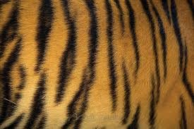
Fur
The basic color of his fur is yellowish
His belly and the beginning of inner thigh is white
Stripes are thin and long

Slide 10
Made by:
Matea and Lukrecija
RAWR!!

