Slide 1
Recipe for pancakes
izradili:
Leon Spahić 5. r
Damjan Laić 5. r
Danijel Valić 5. r

Slide 2
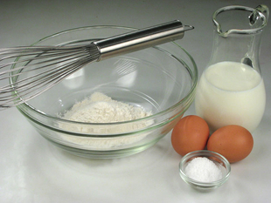
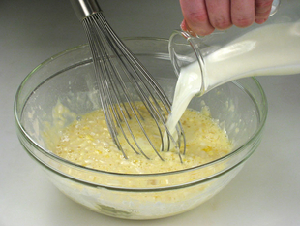
Procedure:
For the pancakes you need 2 cups of flour,
one egg, one cup of milk and spoon of sugar.
First mix the eggs and the milk.
Then add the flour.
After that put in a spoon of sugar.

Slide 3
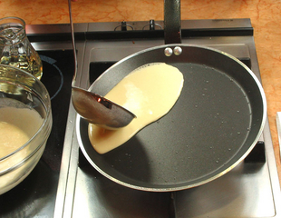
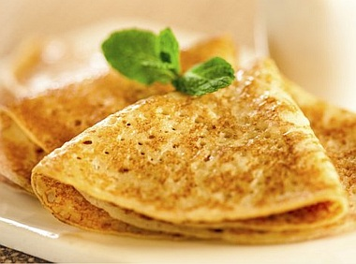
Procedure 2 :
Finally fry the pancakes.
Serve the pancakes with jam or chocolate.

Slide 4
THE END OF RECIPE
YUMMY!

