Slide 1
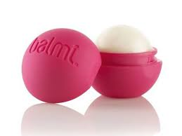
Cola lip balm

Slide 2
Cola lip balm
We have decided to develop a new lip balm.
We will call it Cola.

Slide 3
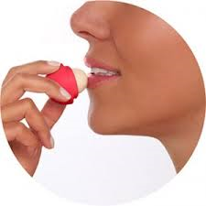
We believe this product will be popular with middle-aged women.

Slide 4
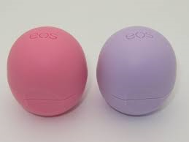
It will be packed in a small plastic container. The container will be in bright colours. We will sell it in supermarkets.

Slide 5
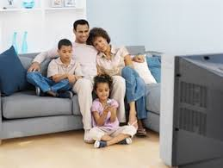
We will advertise our product on television because then many people will see it.

Slide 6
The first time you buy our product you will get a free gift!!

Slide 7
Made by: Korina B. & Anita U.

